Slide 1

Population Line and Step Charts
DSC640 Week 3 and 4
Shaquiel Pashtunyar

Slide 2
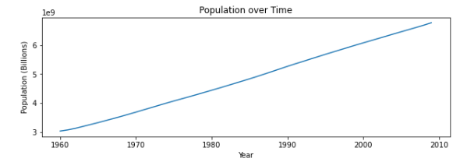
Python Line Chart
plt.plot(Population["Year"], Population["Population"])
plt.title('Population over Time')
plt.xlabel('Year')
plt.ylabel('Population (Billions)')
plt.show()

Slide 3
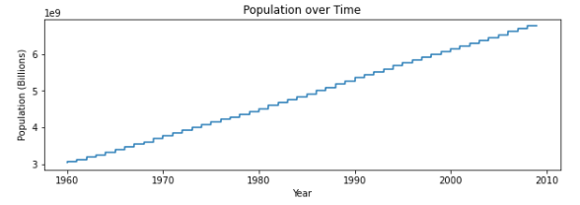
Python Step Chart
plt.step(Population["Year"], Population["Population"])
plt.title('Population over Time')
plt.xlabel('Year')
plt.ylabel('Population (Billions)')
plt.show()

Slide 4
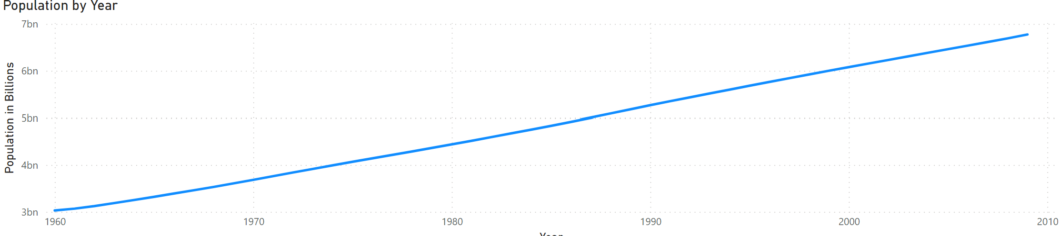
Power BI Line Chart

Slide 5
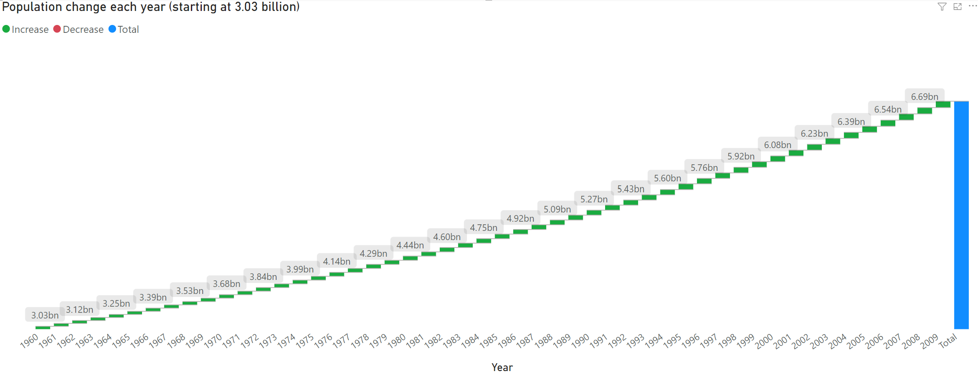
Power BI Step Chart

Slide 6
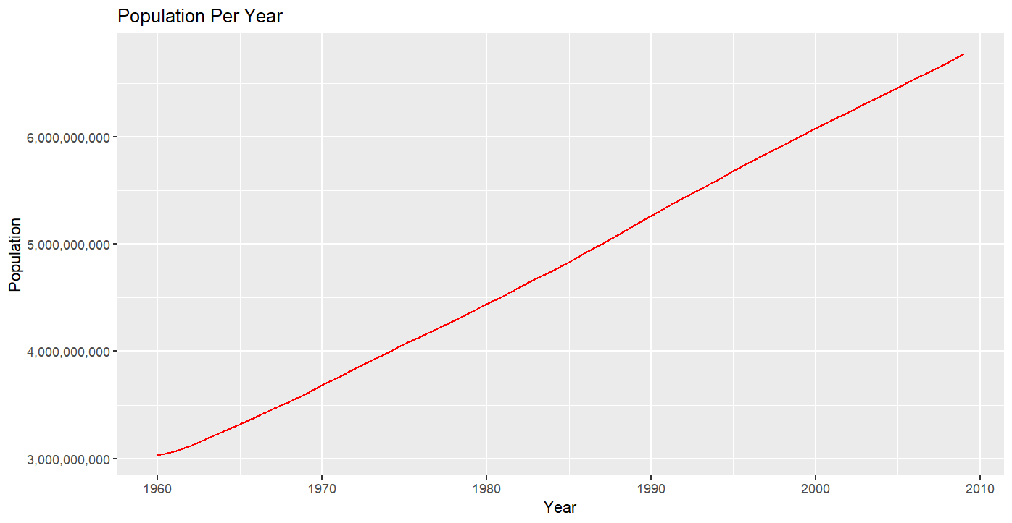
R Line Plot
ggplot(Pop_df, aes(x=Year, y=Population)) + geom_line(color="red")+ ggtitle("Population Per Year")+ scale_y_continuous(labels = scales::comma)

Slide 7
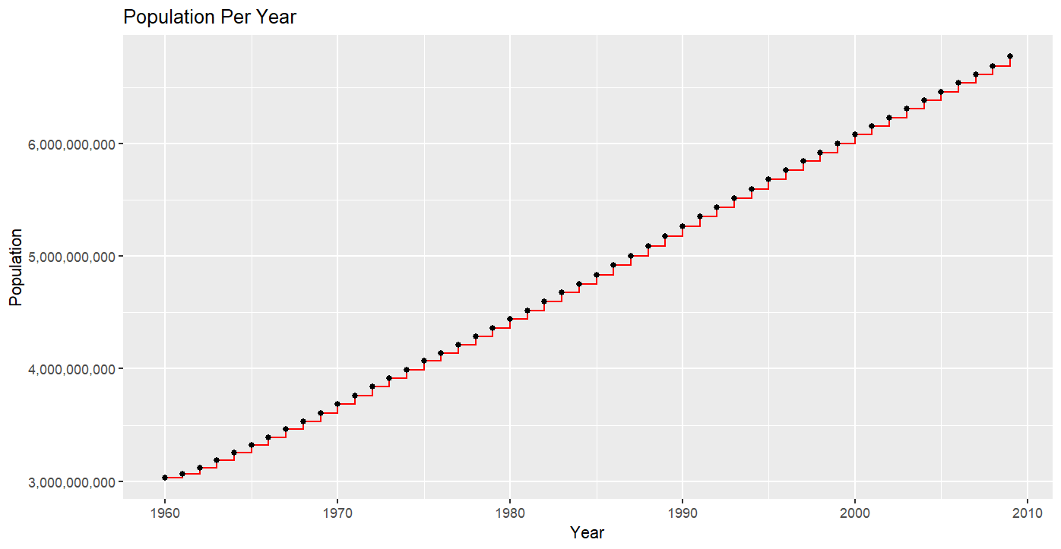
R Step Chart
ggplot(Pop_df, aes(x=Year, y=Population)) + geom_step(color="red")+ ggtitle("Population Per Year")+ scale_y_continuous(labels = scales::comma)+ geom_point()

